Slide 1
Trees

Slide 2
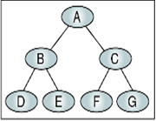
Tree Overview
A tree is mainly used to represent data containing a hierarchical relationship between elements e.g records, Family trees.
Binary Trees:
A Binary Tree T is defined as a finite set of elements called nodes such that:
1) T is empty(Called Null tree or empty tree), OR
2) T contains a distinguished node R, Called the root of T, and the remaining nodes of T form an ordered pair of disjoint binary trees T1 and T2.
If T does Contains a root R, then the two trees T1 and T2 are called respectively the left and right sub trees of R.

Slide 3
Any node N in a binary tree has either 0,1 or 2 successors.
The nodes with no successors are called terminal nodes.
Binary trees T and T’ are said to be similar if they have the same structure or in other words they have the same shape.
The trees are said to be copies if they are similar and if they have the same contents at the corresponding nodes.
Terminology
Suppose N is a node in T with left successor S1 and right successor S2. Then N is called the parent (or father) of S1 and S2.
S1 is called left child of N, and S2 is called right child of N.
S1 and S2 are said to be siblings( or brothers).
Every node N in binary tree, except root has unique parent, called predecessor of N

Slide 4
The line drawn from a node N of T to a successor is called an edge
The sequence of consecutive edges is called a path.
A terminal node is called a Leaf.
A path ending in leaf is called a Branch.
Every node in binary tree T is assigned a level number. The root R of the tree T is assigned the level number 0 and every other node is assigned a level number which is 1 more than the level number of its parent. Further the nodes with same level number are said to belong to the same generation.
The Depth(or height) is the maximum number of nodes in a branch of T. This turns out to be 1 more than the largest level number of T.

Slide 5
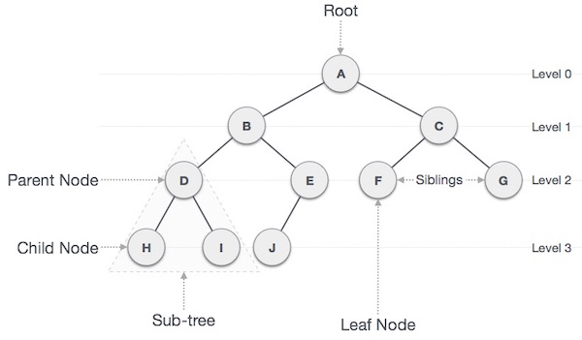

Slide 6
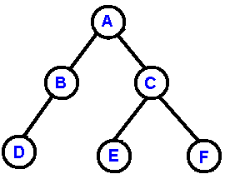
Binary Tree
A binary tree is made of nodes, where each node contains a "left" reference, a "right" reference, and a data element.
The topmost node in the tree is called the root.
Every node (excluding a root) in a tree is connected by a directed edge from exactly one other node. This node is called a parent.
On the other hand, each node can be connected atmost two children nodes.
Nodes with no children are called leaves, or external nodes.
Nodes which are not leaves are called internal nodes. Nodes with the same parent are called siblings.

Slide 7
Complete Binary Tree:
1) Each Node of T can have at most 2 children. Accordingly one can show that level r of T can have at most 2^{r} nodes.
The tree is said to be complete if all its levels except possibly the last have the maximum number of possible nodes, and if all the nodes at the last level appear as far left as possible.
One can easily determine the children of node K are (2*K, 2*K+1), respectively, And parent of any node K is K/2.
The depth of complete tree with n nodes is given by
D = | Log₂ n + 1 |
Eg- the complete tree with n = 1000000 nodes, the depth is 21

Slide 8
Extended Binary Trees: 2-Trees
A binary tree T is said to be a 2-tree or an extended binary tree if each node N has either 0 or 2 Children.
In such case the nodes with 2 children are called internal nodes and nodes with 0 children are called external nodes.
Representation of Trees in Memory
A binary tree data structure is represented using two methods. Those methods are as follows...
Array Representation
Linked List Representation

Slide 9
Sequential Representation of a tree.
1) The root Node R of T is stored at Tree[1].
2) If a node occupies Tree[K], then its left child is stored in Tree[2*K] and its right
Child is stored in Tree[2*K+1]
Note:- The sequential representation or array of a tree with depth d will require an array with approx. 2^{d+1} Elements. So this representation is usually inefficient.
Eg- a tree with 11 nodes and depth 5 will require an array with approx. 2⁶ = 64 elements.

Slide 10
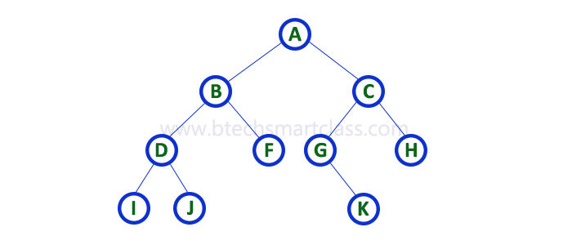

Array Representation
In array representation of binary tree, we use a one dimensional array (1-D Array) to represent a binary tree.
Consider the above example of binary tree and it is represented as follows...

Slide 11

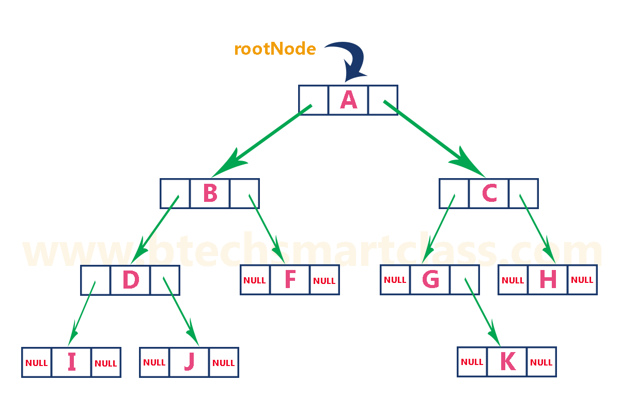
Linked Representation
We use double linked list to represent a binary tree. In a double linked list, every node consists of three fields. First field for storing left child address, second for storing actual data and third for storing right child address.
In this linked list representation, a node has the following structure...
The previous example of binary tree represented using Linked list representation is shown as follows...

Slide 12
Operation on Trees:
Traversing.
Insertion.
Searching.

Slide 13
Traversing Binary Trees:
Preorder Algorithm:
a) Process the root R.
b) Traverse the left sub tree of R in Preorder.
c) Traverse the Right sub tree of R in Pre order.
preorder (root)
Step 1: Start
Step 2: Display Root
Step 3: Function Call preorder(root->left)
Step 4: Function Call preorder(root->right)
Step 5: Stop

Slide 14
In-order :
a) Traverse the left sub tree of R in In order.
b) Traverse the Root R.
c) Traverse the Right Sub tree in in order.
inorder (root) Algorithm
Step 1: Start
Step 2: Function Call inorder(root->left)
Step 3: Display Root
Step 4: Function Call inorder(root->right)
Step 5: Stop

Slide 15
3) Post Order :
a) Traverse the left sub tree of R in Post order.
b) Traverse the Right Sub tree in Post order.
c) Traverse the Root R.
postorder (root) Algorithm
Step 1: Start
Step 2: Function Call postorder(root->left)
Step 3: Function Call postorder(root->right)
Step 4: Display Root
Step 5: Stop

Slide 16
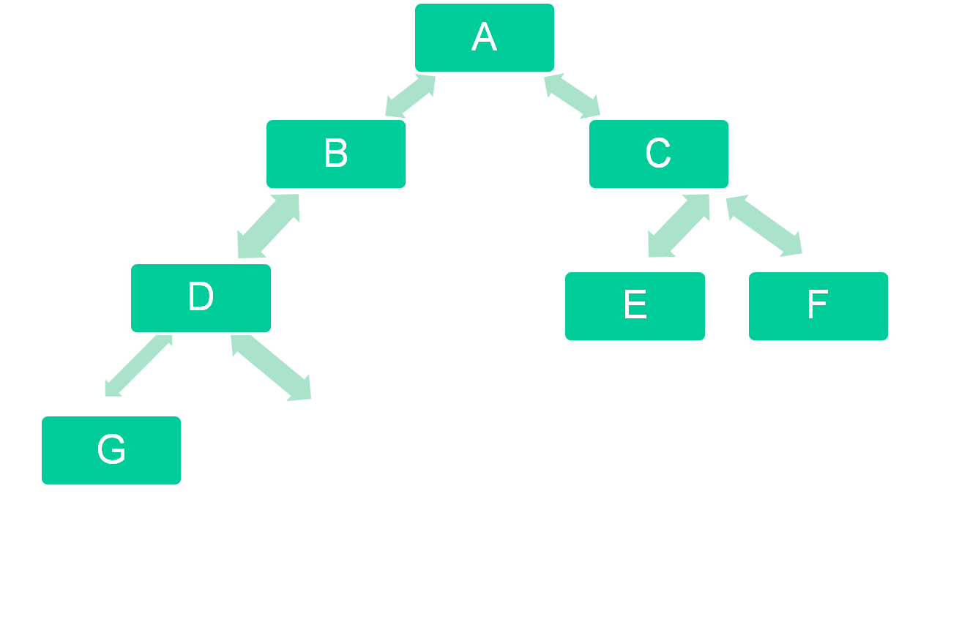
A,B,D,G,H,K,C,E,F
Example :
→ PreOrder
H
K

Slide 17
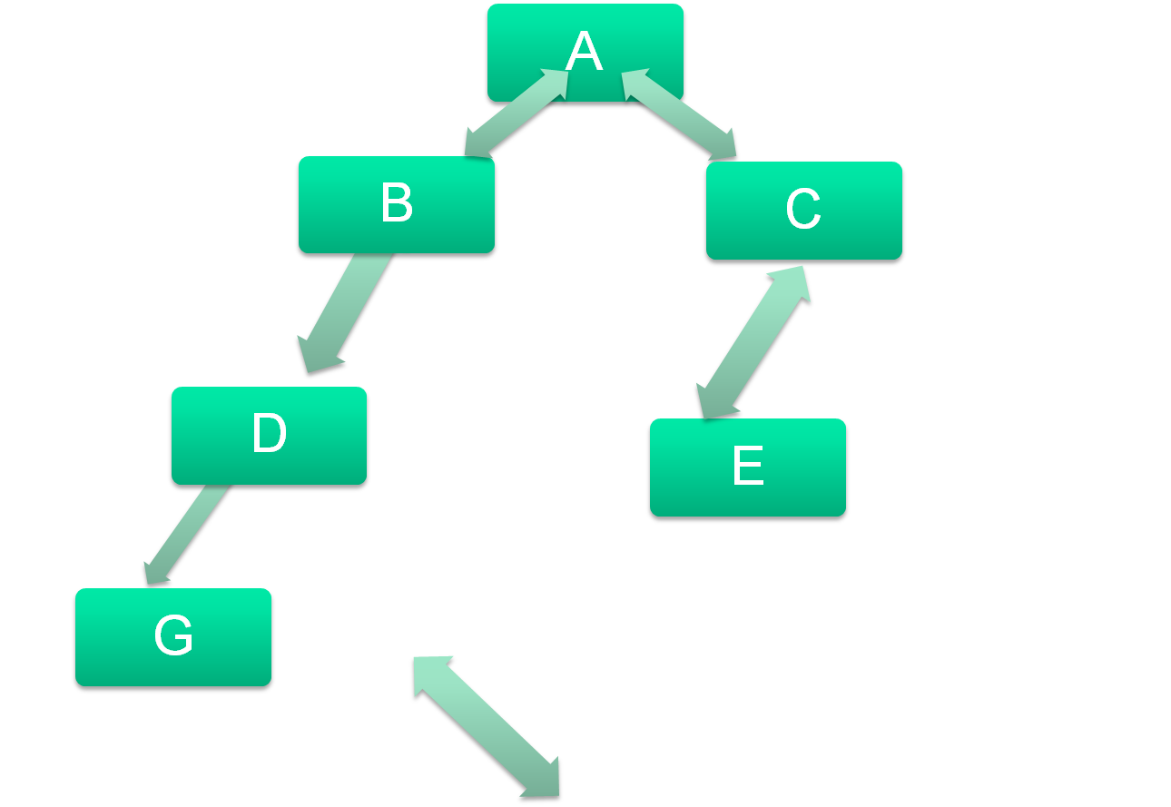
K,G,D,L,H,M,B,A,E,C
→ In Order
H
K
L
M

Slide 18
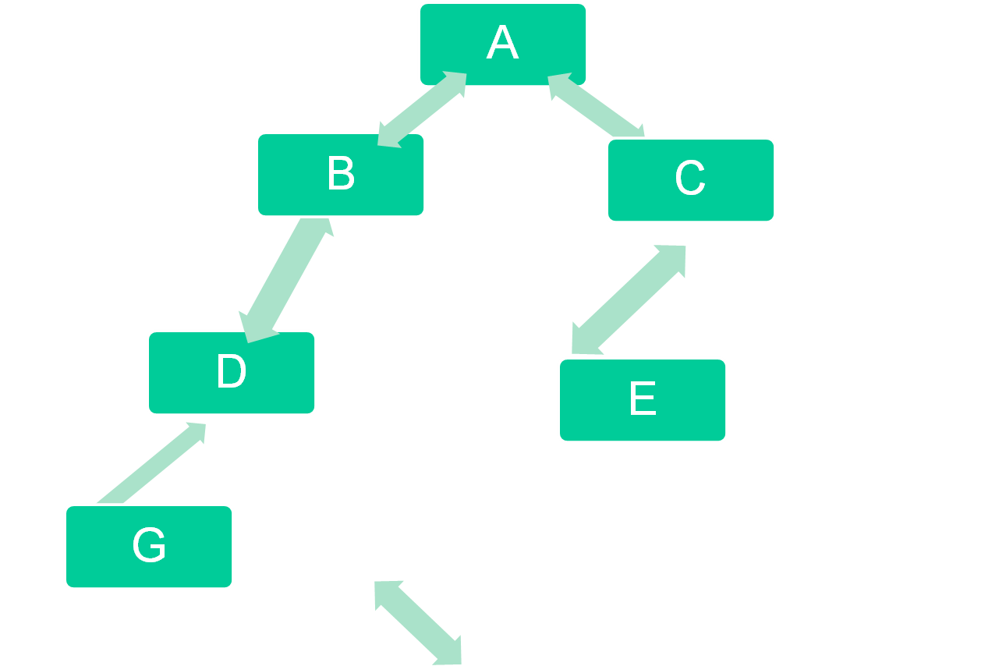
K,G,L,M,H,D,B,E,C,A
→ Post Order
H
K
L
M

Slide 19
Binary Search tree
Suppose T is a binary tree. Then T is called a binary search Tree if each Node N of T has the following property.
The value of N is greater than every value in the left subtree of N and is less than every value in the right subtree of N.
A binary search tree is a binary tree such that for every node in the tree, all of the entries in the left sub-tree (if any) are smaller than the entry in the node and all of the entries in the right sub-tree (if any) are larger than the entry in the node.
6
6
3
7
5
7
2
5
9
2
3
9
a binary search tree
not a binary search tree
Note: there is no requirement that a binary search tree be a complete binary tree.

Slide 20
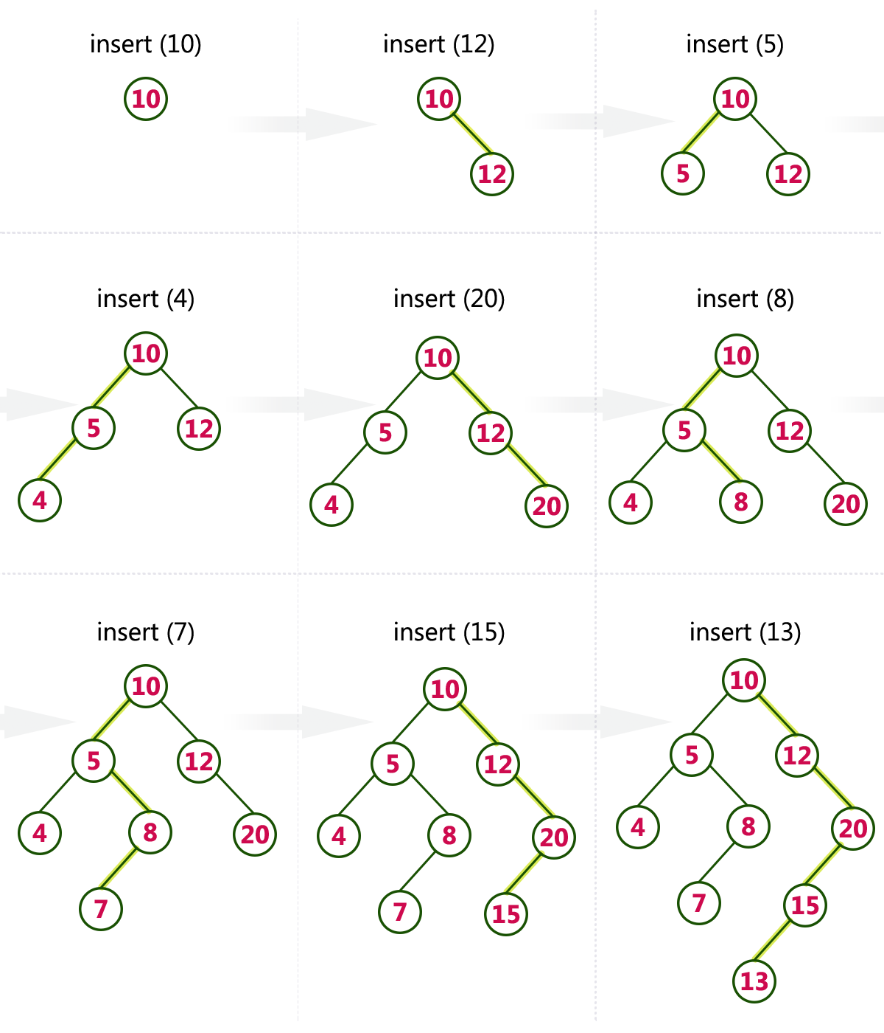
Make a BST of list 10,12,5,4,20,8,7,15 and 13

Slide 21
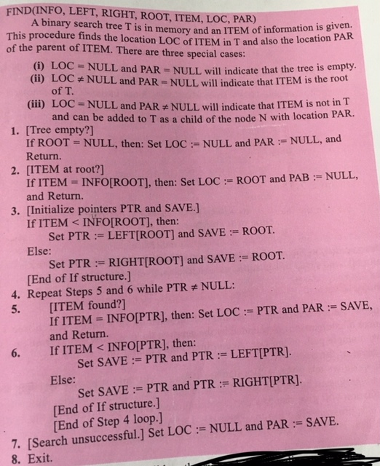


Slide 22
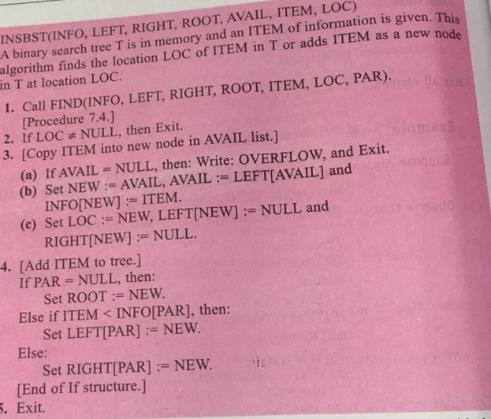

Slide 23
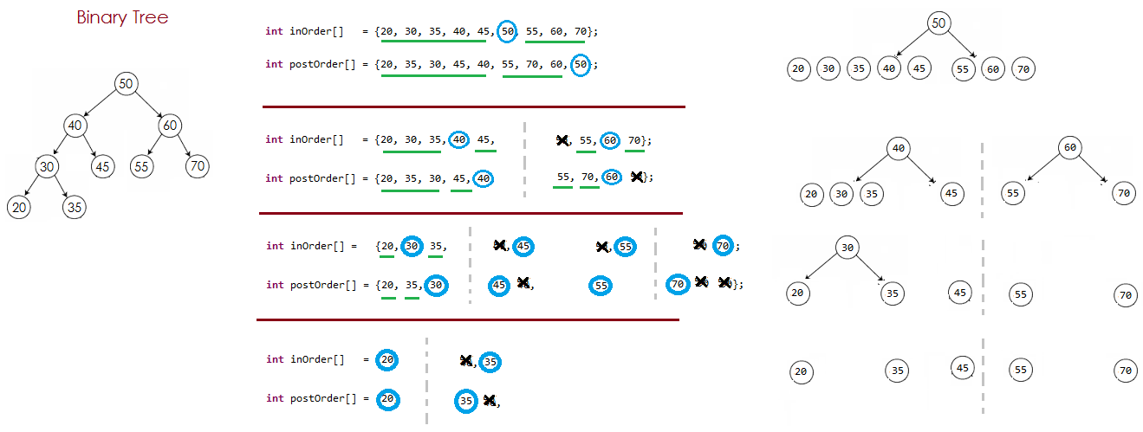
Draw a Binary search tree from given traversal orders
Case 1 : Inorder and PostOrder

Slide 24
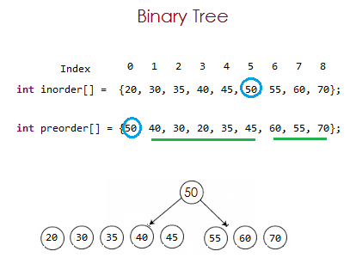
Draw a Binary search tree from given traversal orders
Case 2 : Inorder and PreOrder

Slide 25
Steps :
Step 1: Read the first element from Pre order traversal which is root node. Now, we come to know which is root node.(in our case it is 50)
Step 2: Search the same element (element 50) in In-order traversal, when the element is found in In-order traversal, then we can very well say that all the elements present before the node found are Left children/sub-tree and all the elements present after the node found are Right children/sub-tree of node found. (as in In-order traversal Left child's are read first and then root node and then right nodes.)
In our example, In-order traversal : 20 30 35 40 45 50 55 60 70
Pre-order traversal : 50 40 30 20 35 45 60 55 70
(20, 30, 35, 40, 45) will be part of Left Sub-tree of Node 50.
(55, 60, 70) will be part of Right Sub-tree of Node 50.
Now we got the fresh inOrder (20, 30, 35, 40, 45) and (55, 60, 70)
Repeat the Step 1 and Step 2 for new inOrder
Note: We will find the root node from Pre-order/Postorder traversal and then left child's and right child's from In-order

Slide 26
Make a binary tree out of these traversals :
1) In-Order: E,A,C,K,F,H,D,B,G
Pre-Order: F,A,E,K,C,D,H,G,B
2) In-order (4,7,2,8,5,1,6,9,3)
Pre-Order(1,2,4,7,5,8,3,6,9)

